Slide 1

MINUTES OF MEETING
AI-Powered Enterprise Meeting Assistant

Slide 2
What is Minutes of Meeting?
Meeting minutes are the written or recorded documentation that is used to inform what was discussed during a meeting.
Meeting minutes or notes are generally taken by a designated person.
Minutes are the live written record of a meeting.
The purpose is to record what actions have been assigned to whom, along with the achievements and the deadlines.

Slide 3
Minutes of Meeting Template
A minute of meeting normally includes the following elements
Name of the company − to the top-left of the page.
Date − to the top-right of the page.
Topic − after two return keys; Center-aligned.
Attendees − Name and designation (2 columns of a table).
Absentees − name, roles, reasons for absenteeism. (3 columns)
Agenda at hand − topic to be discussed.
Issues raised − along with the names of the speakers.
Suggestions − made along with the names of the speakers.
Decision − the outcome of the meeting.
Task List − task allotted and the respective allottee.
Future Meetings − the date and topic of the next meeting.

Slide 4
Project Motivation
What it is the importance of this document in professional organizations?
Written record
Bring all attendee on same page
Measuring stick
How the organizations produce this document?
During the meeting a designated person take notes
After the meeting organize all the points and present a formal document
The current technology will make the work easier
Natural Language Processing
Audio / Video Processing
Notes:
`

Slide 5
Project Definition
In this FYP we will automate the process of generation of Minutes of the Meeting. This project will be Research and Product based.

Slide 6
Project Stakeholders
This product will be mainly used by corporate organizations and individuals which conducts meeting and maintains the record of it.

Slide 7
Project Scope
This project will only compute Minutes with Meeting having English Language as medium of discussion.
Only the things discussed in the meeting will only be included in the process of generation of minutes of meeting.

Slide 8
Existing Solutions
REASON8.AI
Mobile Application - Each participant needs the app on their mobile
OTTER.AI
Mobile Application - On single mobile
Import audio and video, take snap of meeting and embed it to meeting notes.
VOCIEA.COM
Mobile and Web Application
Harder to Setup
Uses an AI assistant as the way to capture your meeting notes.

Slide 9
Literature Review
A just-in-time keyword extraction from meeting transcripts using temporal and participant information by Hyun-Je Song, Junho Go, Seong-Bae Park, Se-Young Park, and Kweon Yang Kim
Improved Keyword and Keyphrase Extraction from Meeting Transcripts by Immanuvel Rajkumar, Sheeba & Vivekanandan, Kumuda
A Supervised Framework for Keyword Extraction From Meeting Transcripts. Audio, Speech, and Language Processing by Liu, Fei & Liu, Feifan & Liu, Yang
Rapid Keyphrase extraction from audio transcripts of video lectures by Aruna, V. & Harini, S. & Ranjitha, R. & Palanivel

Slide 10
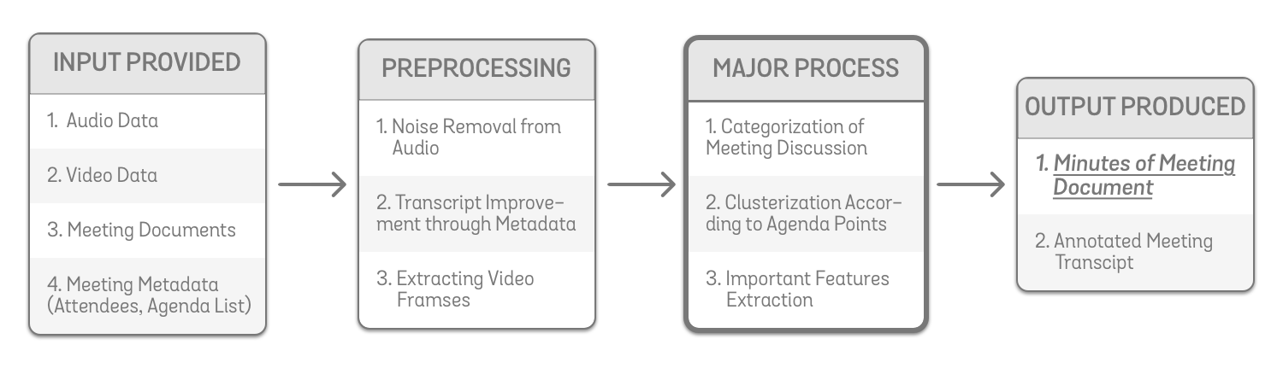
Architecture Block Diagram (Generic)

Slide 11
Input Data for Task
Meeting’s Audio and Video Recording
It will help us to get the transcript of meeting.
Meeting’s Metadata
Organization name, Meeting’s date, time, venue, attendees, absentees, and Meeting’s agenda list
It will help us to get compute the minutes accurately.
Also, it will help us to improve the transcript generated from audio data.
Meeting’s Document (Reports and Charts)
It will help us to get the figures quoted in meeting.

Slide 12
Major Processes Involved
Speaker Diarization
Partition the audio stream into dialogues of different attendees.
Text to Speech
Convert Meeting’s audio data to Meeting’s transcript.
Document’s Optical Character Recognition
Extract the information from the documents as text.
Categorization of Meetings Points
(Agenda Discussion, Task Assigned and Recommendations)
Clustering of Meetings Discussion according to Agenda
All discussion regarding an agenda will be gathered.
Extracting Important Features from Discussion
To finalize the Minutes of the Meeting’s draft

Slide 13
Indications of Important Features
Topic Sentence of Agenda discussed
Frequently told fact regarding a meeting agenda
Some figure told such as Progress Rate, Success Rate
Points extracted from Document
Any event or date told

Slide 14
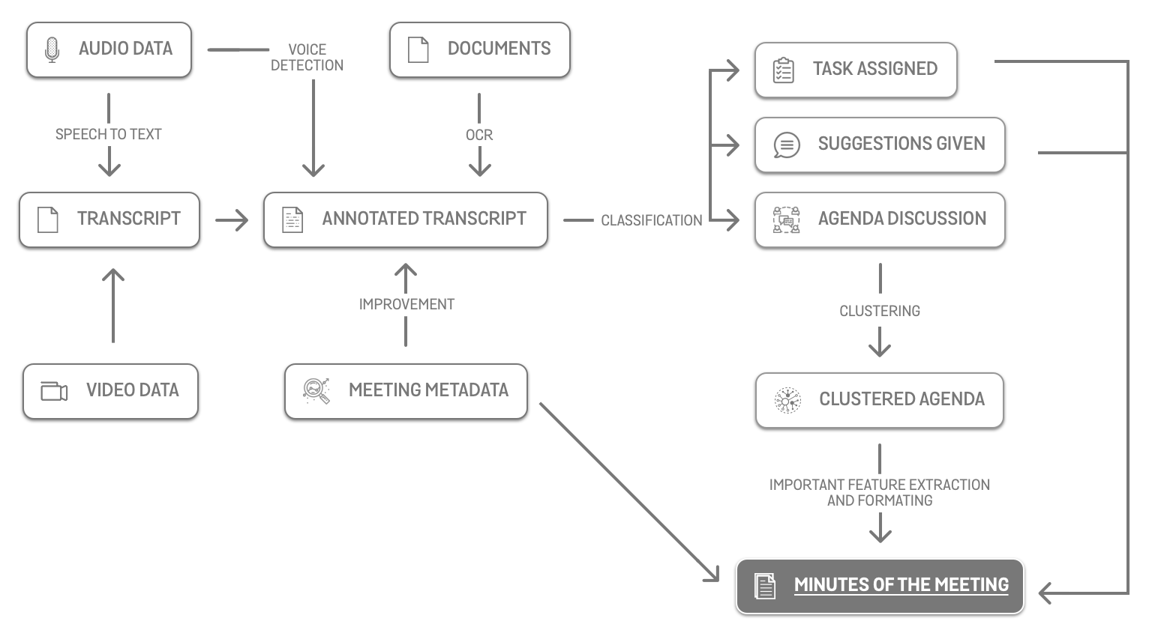
Architecture Block Diagram (Detailed)

Slide 15
Project Features
Annotated Transcription of meeting minutes
Speaker Identification and Diarization
Noise Agnostic
Exportable and Shareable Document
Secure and Private
Persists History
Multiple device-independent

Slide 16


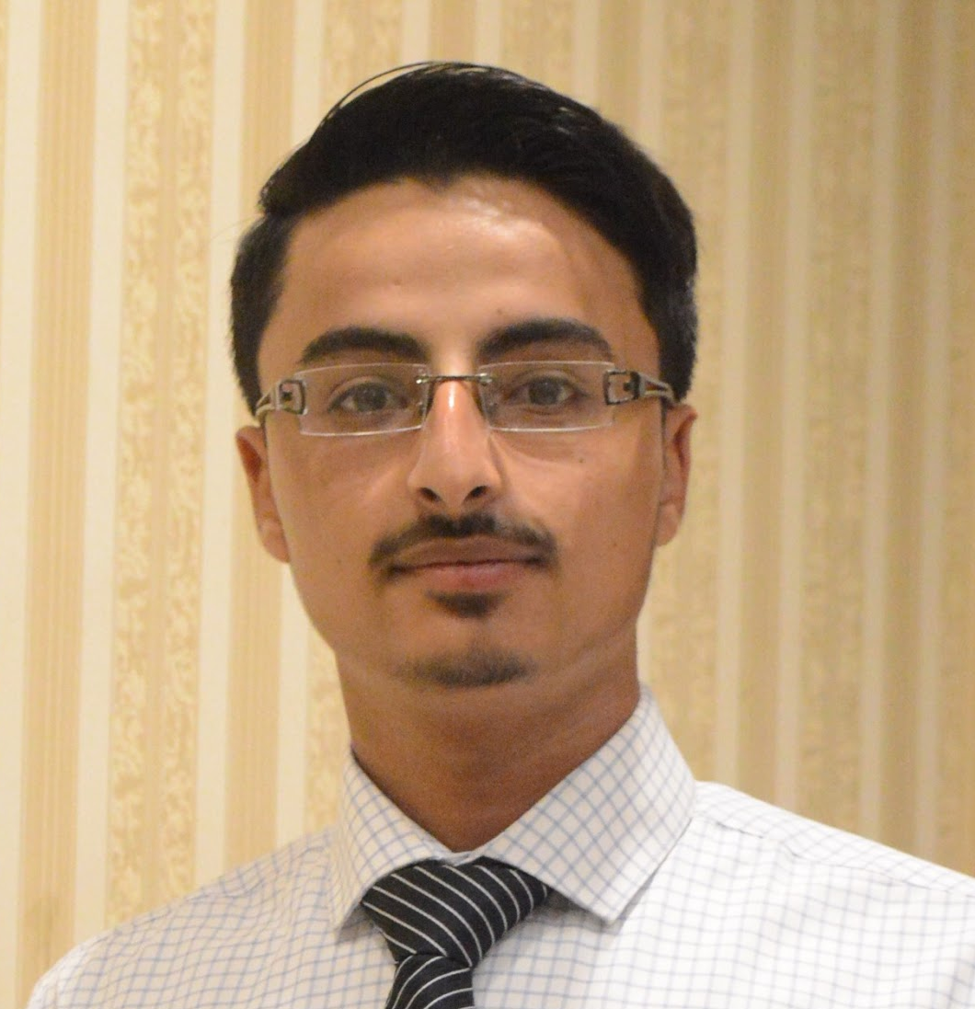

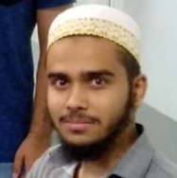

Dr. MUHAMMAD RAFI
Mehdi Raza Rajani
(FYP SUPERVISOR)
Email Address: muhammad.rafi@nu.edu.pk
LinkedIn: muhammad-rafi-34339219
(GROUP LEADER)
Email Address: k163904@nu.edu.pk
GitHub: mehdirazarajani
LinkedIn: mehdirazarajani572
TEAM MEMBERS
Hussain Yousuf
Hussain Yousuf
Shehryar Naeem
Email Address: k163805@nu.edu.pk
GitHub: HussainYousuf
LinkedIn: hussain-yousuf-93c3757
Email Address: k163950@nu.edu.pk
GitHub: shehryarnaeem
LinkedIn: shehryar-naeem-291a3016b

Slide 17
Conclusion
Meetings are essential for sharing information
Advance technology will automate the meeting’s minutes generation process
AI-powered voice note application for automated note-taking and summary preparation for in-person meetings
Enterprise Meeting Assistant - E.M.A will join your session and record the meeting, observe the speaker, and extract essential pointers from the attached documents
Some metadata will be given as input to the system
Clumps the meeting points according to the agenda of the meeting
Assign tasks to attendees

Slide 18
Questions Answers

Slide 19
MINUTES OF MEETING
The End
THANK YOU

